Slide 1
Retail sales Analysis Dashboard
Presented By :
Fathima Fidha Nv

Slide 2
Project Overview
Dataset Overview Data Cleaning Performed
Retail sales dataset containing 80,000+ records .
Includes customer, product, sales, profit, region, category and order information .
Data cleaned and prepared for analysis.
Removed duplicate records .
Standardized date formats .
Converted Sales and Profit columns to numeric values .
Handled missing values .
Created Year and Month fields for analysis .

Slide 3
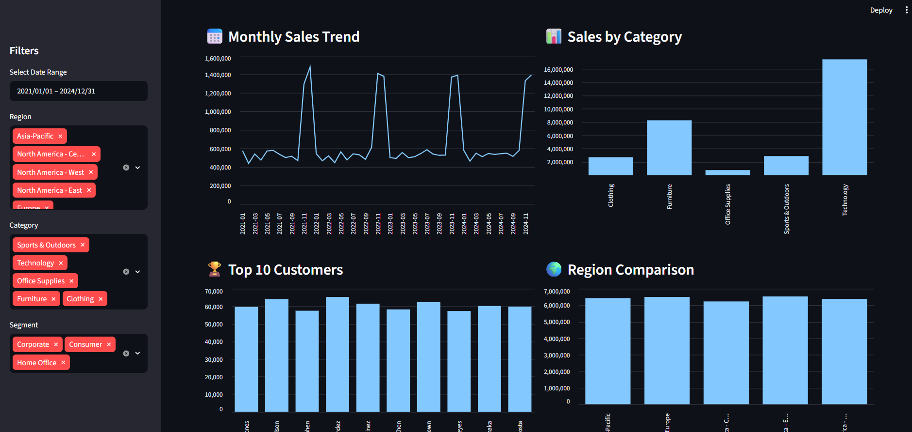
Dashboard Features
KPI Tracking
Interactive Filters
Regional Analysis
Sales Trend Analysis
Customer Analysis

Slide 4
KPI Summary Key Performance Indicators
Orders
80000
Revenue
32.09million
Profit
9.42 million
Average order value
401
Profit margin
29.35%

Slide 5
Top 5 Insights
Insight 1
Technology products generated the highest sales revenue among all categories.
Insight 2
Sales increased significantly during November and December, indicating strong seasonal demand.

Slide 6
Insight 3
Laptops and Smartphones were the highest-performing product subcategories.
Insight 4
Sales performance across regions was relatively balanced, reducing dependence on a single market.
Insight 5
Revenue was distributed among many customers, reducing customer concentration risk.

Slide 7
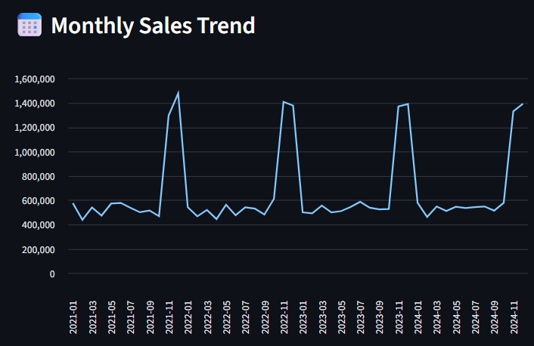
Monthly Sales Trend
December consistently records the highest sales.
Sales increase significantly during the final quarter of the year.
Strong seasonal demand pattern observed.
Peak sales occur during holiday shopping periods.

Slide 8
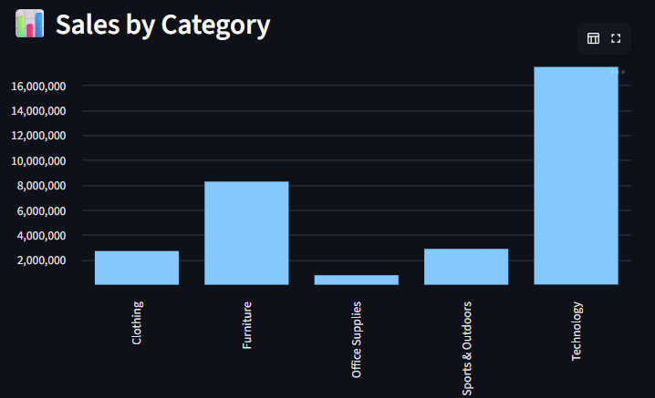
Category Analysis
Technology generated the highest sales.
Furniture was the second-best performing category.
Electronics products contributed significantly to revenue.

Slide 9
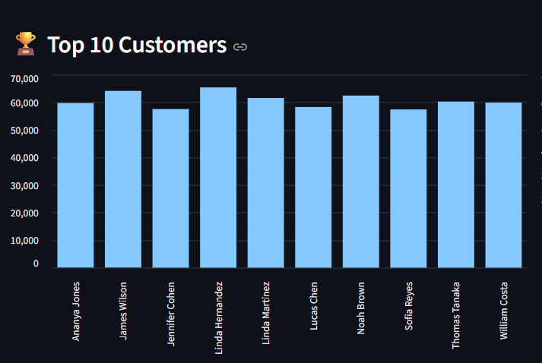
Customer Analysis
High-value customers contribute significantly to revenue.
Customer retention is important for long-term growth.
Loyalty programs can increase repeat purchases.

Slide 10
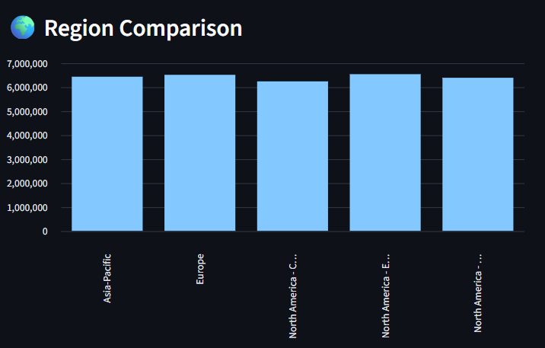
Region Analysis
North America East generated the highest revenue.
Regional sales were relatively balanced.
Growth opportunities exist in lower-performing regions.

Slide 11
Key Findings
01
Technology is the highest-performing category.
03
North America East generates the highest revenue.
02
December is the strongest sales month.
04
Top customers significantly impact overall sales.

Slide 12
Recommendations
Recommendation 1
Increase inventory and promotions for Technology products.
Recommendation 2
Prepare inventory and marketing campaigns before the holiday season.
Recommendation 3
Strengthen customer loyalty and retention programs.
Recommendation 4
Expand successful products into lower-performing regions.

Slide 13
Thank You

